Slide 1




Conducting Causal Research

Slide 2
Recap Last Class

Slide 3
Learning Objectives
Discuss the three general types of primary data research
Clarify the difference between lab experiments and field experiments.
Explain which of the two types of experiments has greater internal validity and which as greater external validity
List the 3 major considerations in test marketing.
Distinguish between a standard test market and a controlled test market
Discuss the advantages and disadvantages of simulated test marketing

Slide 4
Three types of Primary Data Research
Exploratory Research
(explore)
Descriptive Research
(describe)
Causal Research
(establish cause and effect)

Slide 5
Three Types of Primary Data Research
Exploratory Research: Research conducted to gain ideas and insights to better define the problem or opportunity confronting a manager.
Descriptive Research: Research in which the major emphasis is on describing characteristics of a group or the extent to which variables are related
Causal Research: Type of research in which the major emphasis is on determining cause-and-effect relationships

Slide 6
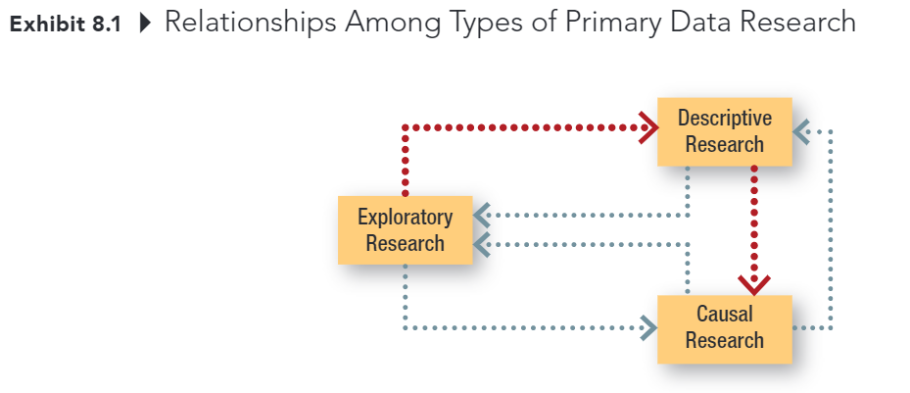
Three Types Primary Data Research

Slide 7

Causal Research
The purpose of causal research is to test cause and effect relationships
condition X causes event Y

Slide 8
Evidence of Causality
Consistent variation – evidence of the extent to which X and Y occur together or vary together in they way predicted by the hypothesis (Correlation condition) spurious correlation
Time order – evidence that shows X occurs before Y
Elimination of other explanations – evidence that allows the elimination of factors other than X as the cause of Y
X – the cause
Y – the effect
Notes:
Correlation does not mean causation.
Even though you can satisfy the first condition, you have to satisfy the other conditions as well in order to establish causal relationship. Hence, many people thought they can
Because we can never know for certain that we have eliminated all other possible causes of an effect, we can never state with certainty that X caused Y.

Slide 9
Experiment
Scientific investigation in which an investigator manipulates one or more independent variables and observes the degree to which the dependent variables change
The basic point of an experiment is to change the levels of one or more X variables and examine the resulting impact on Y while at the same time controlling (holding constant) other variables that might impact Y
Lab experiment: Research investigation in which investigators create a situation with exact conditions to control some variables and manipulate others
Field experiment: research study in a realistic situation in which one or more independent variables are manipulated by the experimenter under as carefully controlled conditions as the situation will permit.

Slide 10
Internal Validity versus External Validity
Internal Validity: The degree to which an outcome can be attributed to an experimental variable and not to other factors. Lab experiments tend to have higher levels of internal validity
External Validity: The degree to which the results of an experiment can be generalized, or extended, to other situations. Field experiments tend to have higher levels of external validity
Online retailers are in an ideal position for conducting field experiments by testing different types or levels of marketing variables simultaneously and examining actual customer response.

Slide 11
Types of Test Markets
Market Testing: A controlled experiment done in a limited butt carefully selected sector of the marketplace
Standard Test Market: A test market in which the company sells the product through its normal distribution channels.
Controlled Test Market: An entire test program conducted by an outside service in a market in which it can guarantee distribution
Simulated Test Market: A study in which consumer ratings are obtained along with likely or actual purchase data often obtained in a simulated store environment; the data are fed into computer models to produce sales and market share predictions.

Slide 12
Recap

Slide 13
5-min Snippet

